Slide 1
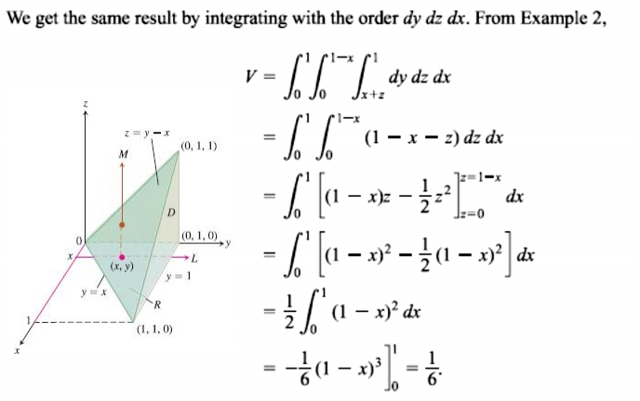
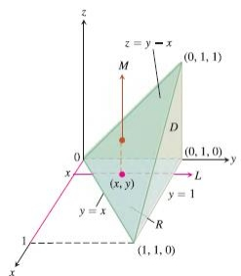
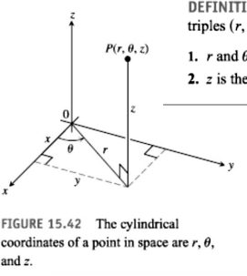
19 / Dep. Of Engineering Mechanics
th
Class: 2 AMTHMATICS / Multiple Integrals

Slide 2
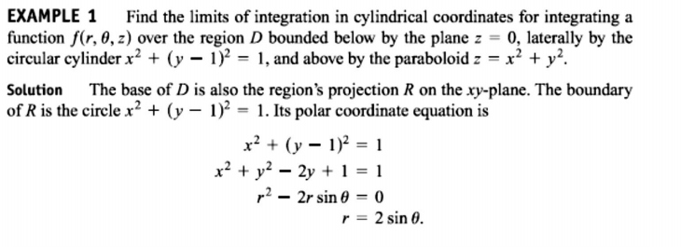
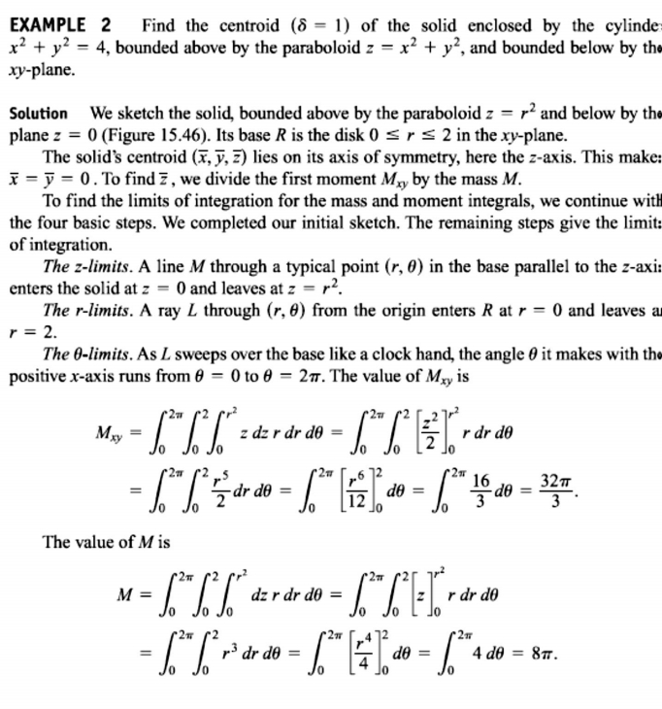
20 / Dep. Of Engineering Mechanics
th
Class: 2 AMTHMATICS / Multiple Integrals

Slide 3
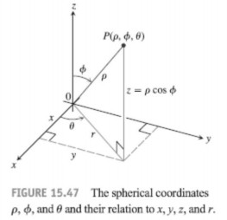
21 / Dep. Of Engineering Mechanics
th
Class: 2 AMTHMATICS / Multiple Integrals

Slide 4
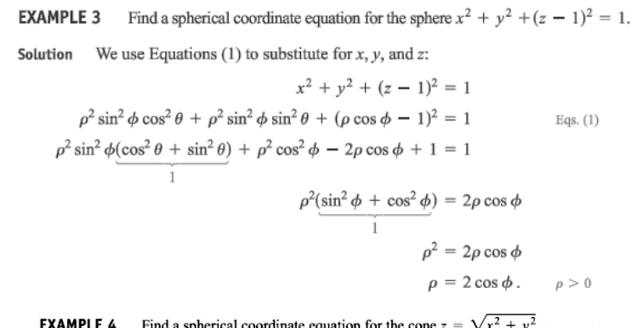
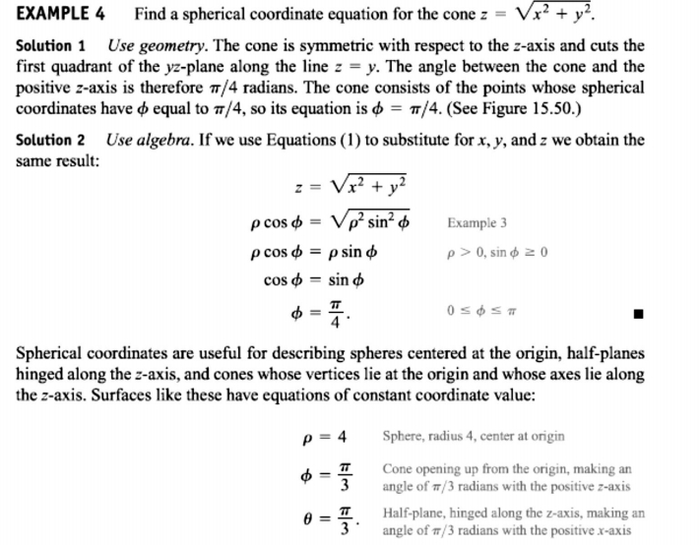
22 / Dep. Of Engineering Mechanics
th
Class: 2 AMTHMATICS / Multiple Integrals

Slide 5
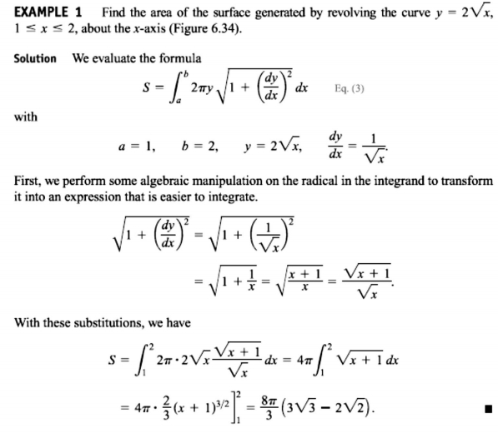
23 / Dep. Of Engineering Mechanics
th
Class: 2 AMTHMATICS / Multiple Integrals

Slide 6
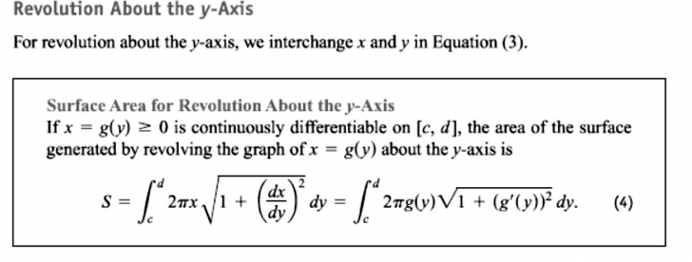
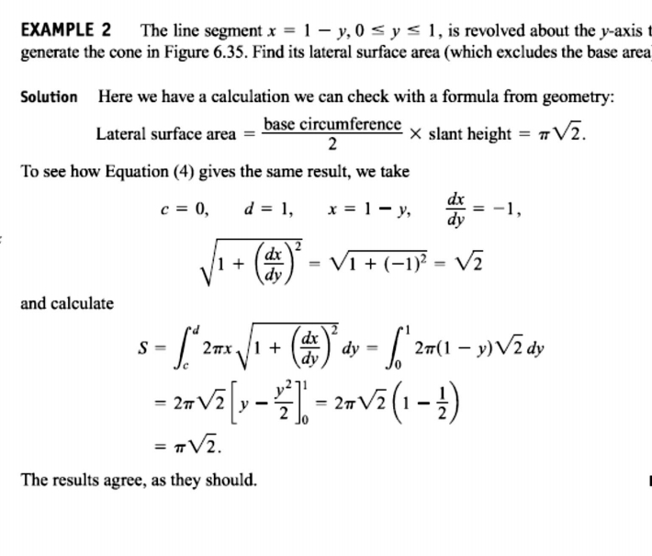
24 / Dep. Of Engineering Mechanics
th
Class: 2 AMTHMATICS / Multiple Integrals

Slide 7
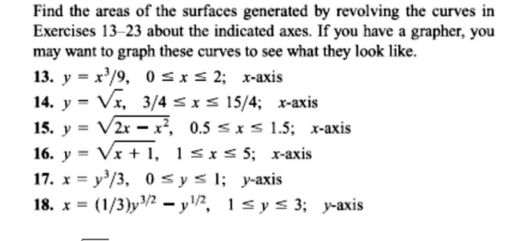
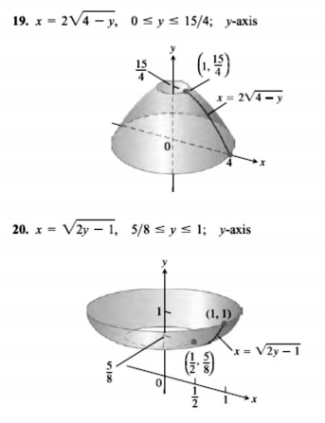
25 / Dep. Of Engineering Mechanics
th
Class: 2 AMTHMATICS / Multiple Integrals

